Slide 1

Surface Analysis
By Muhammad Akhlad
508132

Slide 2

What is surface analysis?
In GIS, surface analysis involves examining geographic features like elevation and slope using spatial data.

Slide 3
How is gis useful in surface analysis?
Elevation Mapping
Slope Analysis
Aspect Analysis
Contour Mapping

Slide 4
Applications of surface analysis
Application | Description
Flood Risk Analysis | Identifies flood-prone areas based on elevation and slope.
Urban Planning | Assists in site selection, construction, and infrastructure development by analyzing terrain features.
Agriculture | Optimizes land use, irrigation, and crop planning based on slope, elevation, and aspect.
Transportation Planning | Evaluates terrain suitability for roads, railways, and infrastructure development.

Slide 5
USGS
Dem Model
Slope map
Aspect map
Diva-GIS
Pak_adm boundary
Clip tool
Study Area Map
Contour map
TIN map
ArcMap

Slide 6
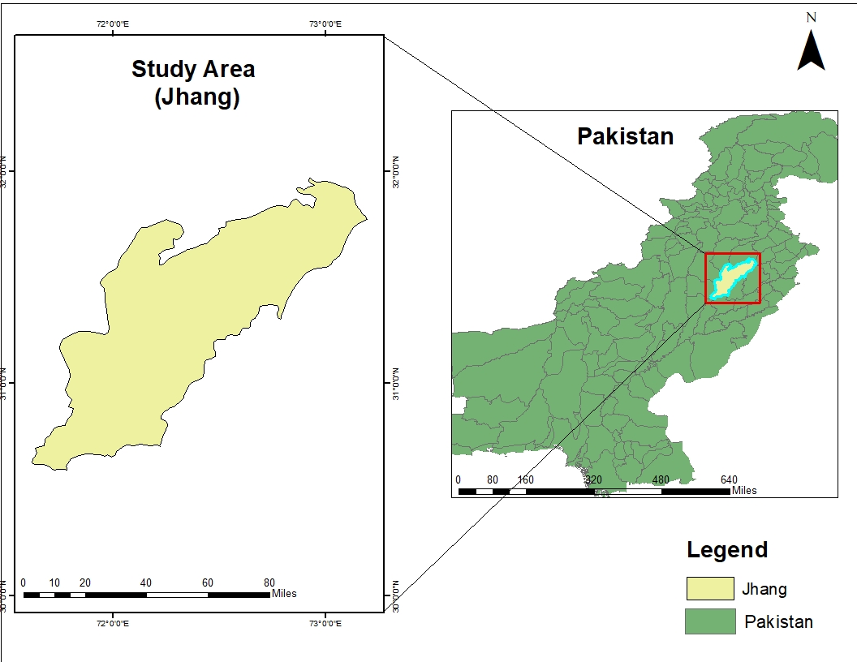

Slide 7
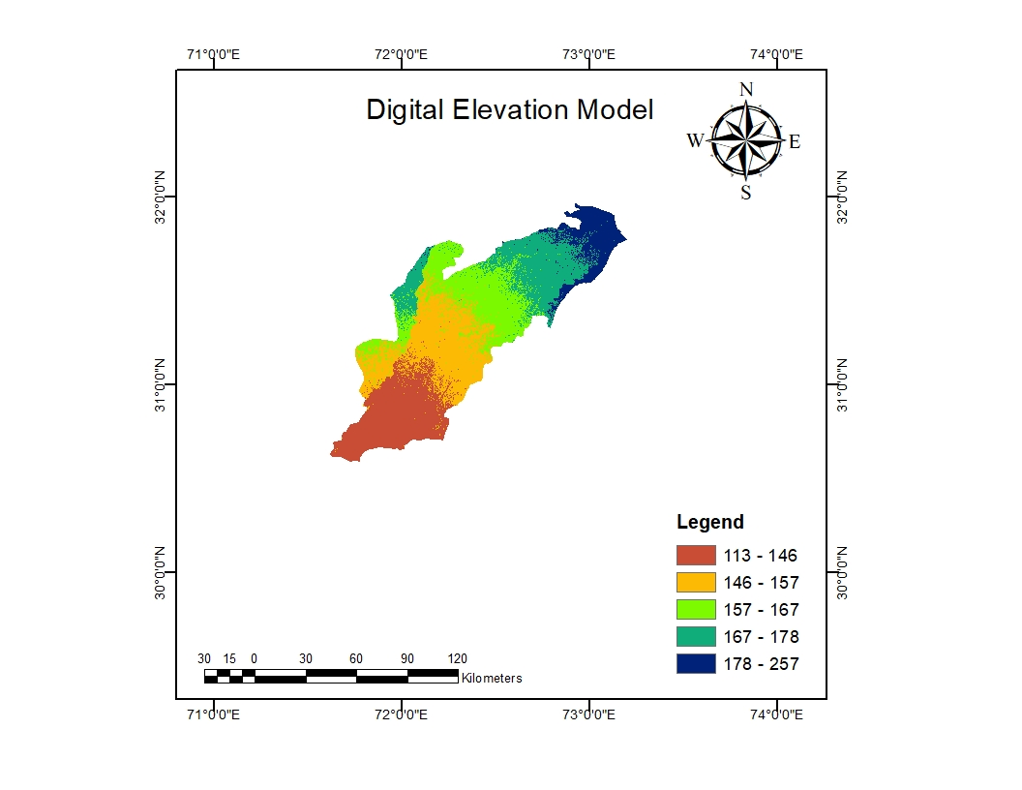

Slide 8
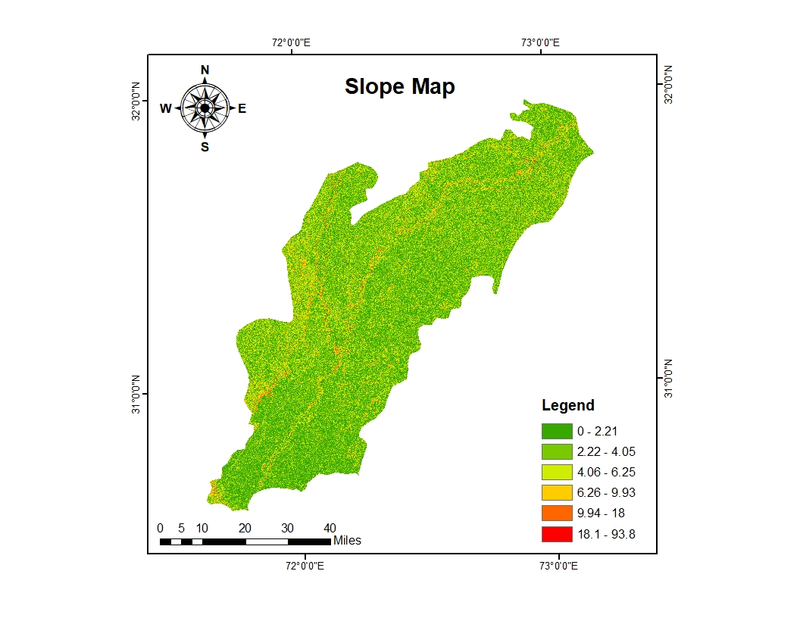

Slide 9
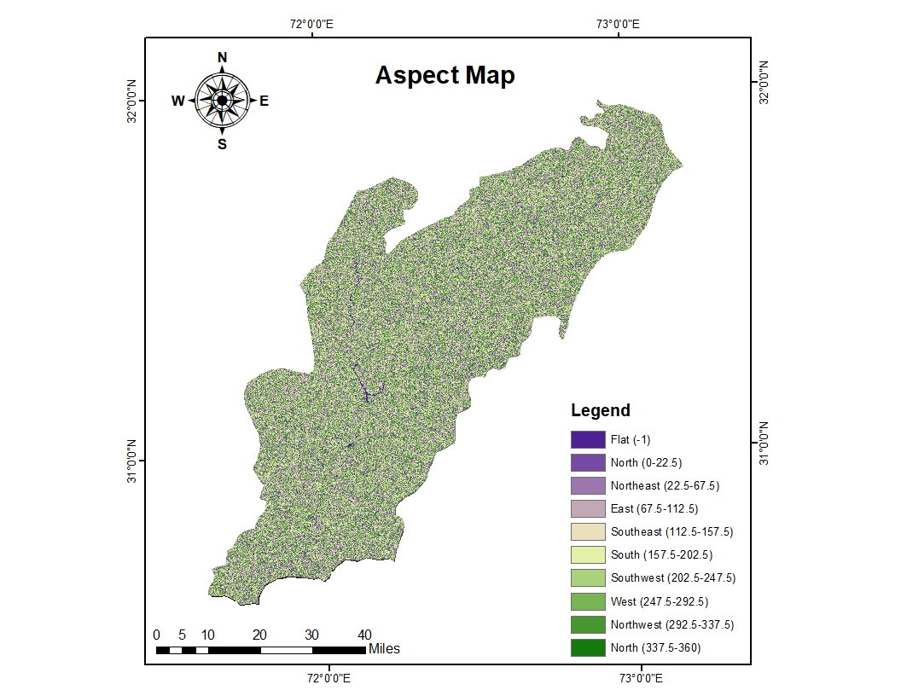

Slide 10
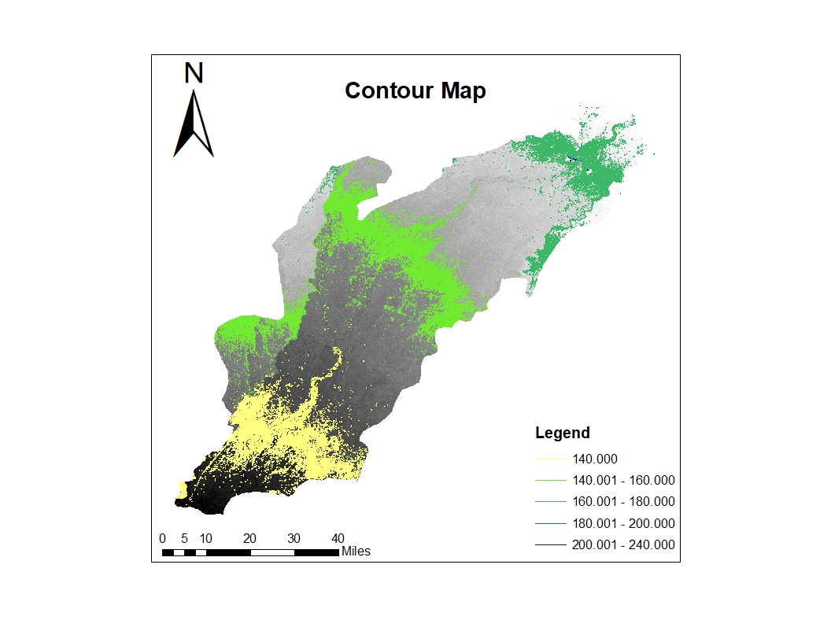
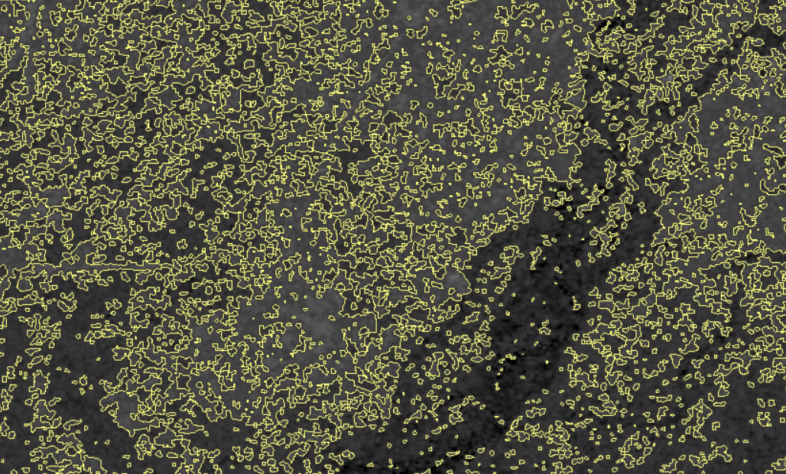

Slide 11
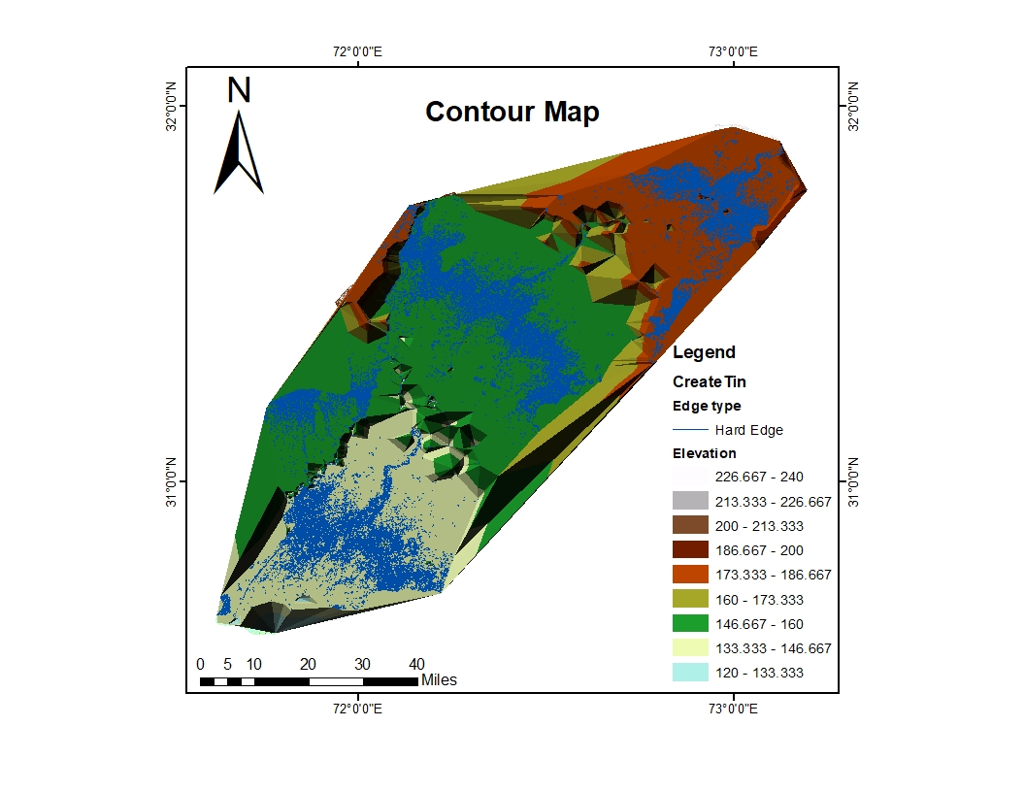

Slide 12
Thank you

